Slide 1
COVID-19 Data Analysis
Insights from Our World In Data

Slide 2
Introduction
This dataset provides COVID-19 related data from [Our World In Data](https://ourworldindata.org/) for analysis and research purposes. The dataset includes various metrics such as total cases, total deaths, vaccination data, and more, organized by country and continent.

Slide 3
Data Source
- **Dataset Name**: Our World In Data - COVID-19 Dataset
- **Data Source**: [COVID-19 Data from Our World In Data](https://covid.ourworldindata.org/data/owid-covid-data.csv)
- **Last Update**: [Check the dataset for the latest update](https://covid.ourworldindata.org/data/owid-covid-data.csv)

Slide 4
Problem Statement
Define the Scope:
Clearly define the scope of your analysis. For example, are you exploring the impact of COVID-19 globally, regionally, or focusing on a specific country?
Specify the Questions:
Clearly state the questions you are seeking to answer through your analysis. For instance:
What are the trends in COVID-19 cases and deaths globally?
How does vaccination coverage vary across different regions?
What demographic factors might influence the spread of the virus?
Highlight the Relevance:
Explain why the problem or questions you're addressing are relevant or significant. Consider the broader context and potential implications.
Provide Context:
Briefly provide context for why understanding COVID-19 trends and related factors is important. This could include public health considerations, policy implications, or societal impact.
Set Expectations:
Manage expectations by mentioning the limitations of your analysis. Acknowledge any constraints in the data or potential uncertainties.

Slide 5
Columns
1. **date**: Date of the data entry.
2. **location**: Country or region name.
3. **continent**: Continent to which the country belongs.
4. **total_cases**: Total confirmed COVID-19 cases.
5. **new_cases**: Daily new confirmed cases.
6. **total_deaths**: Total confirmed COVID-19 deaths.
7. **new_deaths**: Daily new confirmed deaths.
8. **total_cases_per_million**: Total confirmed cases per million people.
9. **new_cases_per_million**: Daily new cases per million people.
10. **total_deaths_per_million**: Total deaths per million people.
11. **new_deaths_per_million**: Daily new deaths per million people.
12. **total_vaccinations**: Total COVID-19 vaccinations.
13. **people_vaccinated**: Total number of individuals who received at least one vaccine dose.
14. **people_fully_vaccinated**: Total number of individuals who received all required vaccine doses.
15. **new_vaccinations**: Daily new COVID-19 vaccinations.
16. **population**: Total population of the country.

Slide 6
Data Cleaning
Briefly discuss any data cleaning steps you performed, handling missing values, converting data types, etc.

Slide 7
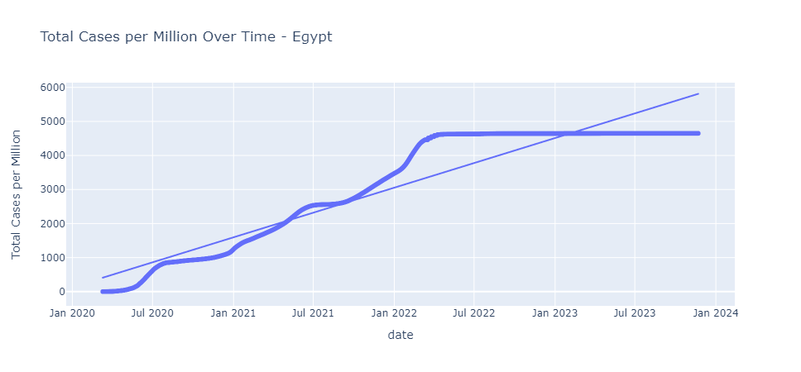
Exploratory Data Analysis (EDA)

Slide 8
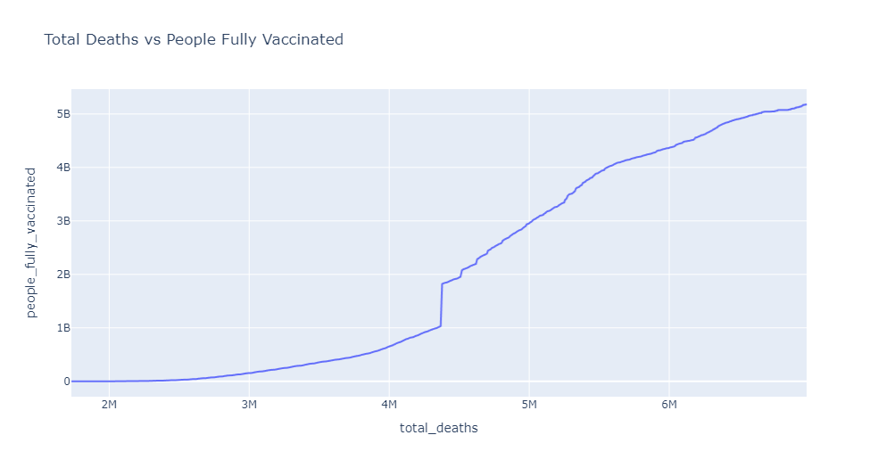
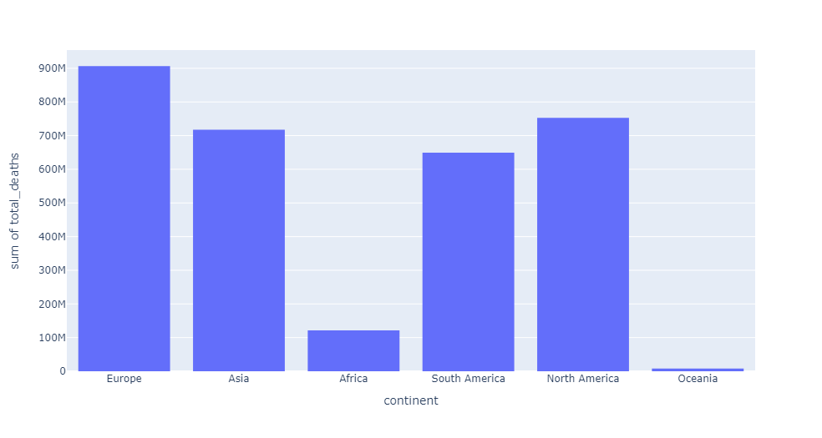
Exploratory Data Analysis (EDA)

Slide 9
Regional Variations

Slide 10
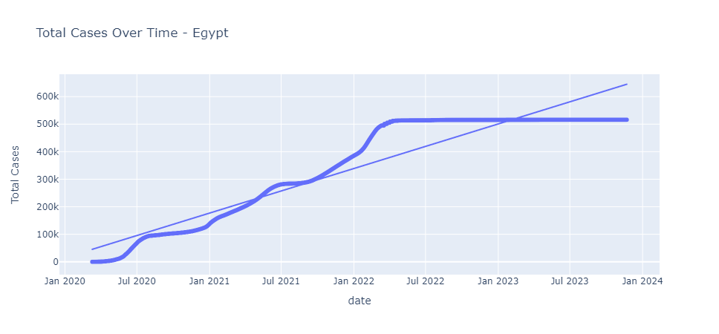
Country-Specific Analysis

Slide 11
Thank You

